Slide 1







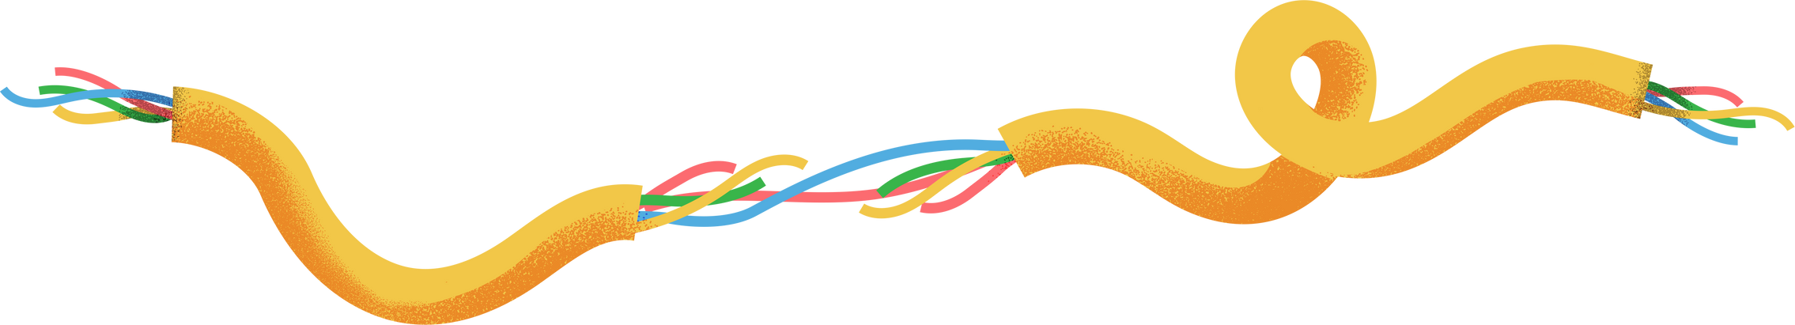


Autonomous Line-Following Car Using MSP430
A self-driving miniature car that follows a track line using an MSP430F5529 microcontroller.

Slide 2







Key Components
MSP430F5529 Microcontroller
IR Sensors for line detection
DC Motor and Driver (L298N)
Servo motor for steering control

Slide 3



Hardware Connections
IR SENSORS
MOTOR DRIVER
SERVO MOTOR
Control Signals: Connected to P2.2–P2.5 for IN1–IN4
Enable Signal: Connected to P1.6 (driven HIGH)
PWM Signal: From MSP430 on P2.0 (using Timer_A1)
Powered by 5 V with a common ground across all components
Left Sensor: Connected to P1.2
Right Sensor: Connected to P1.4

Slide 4


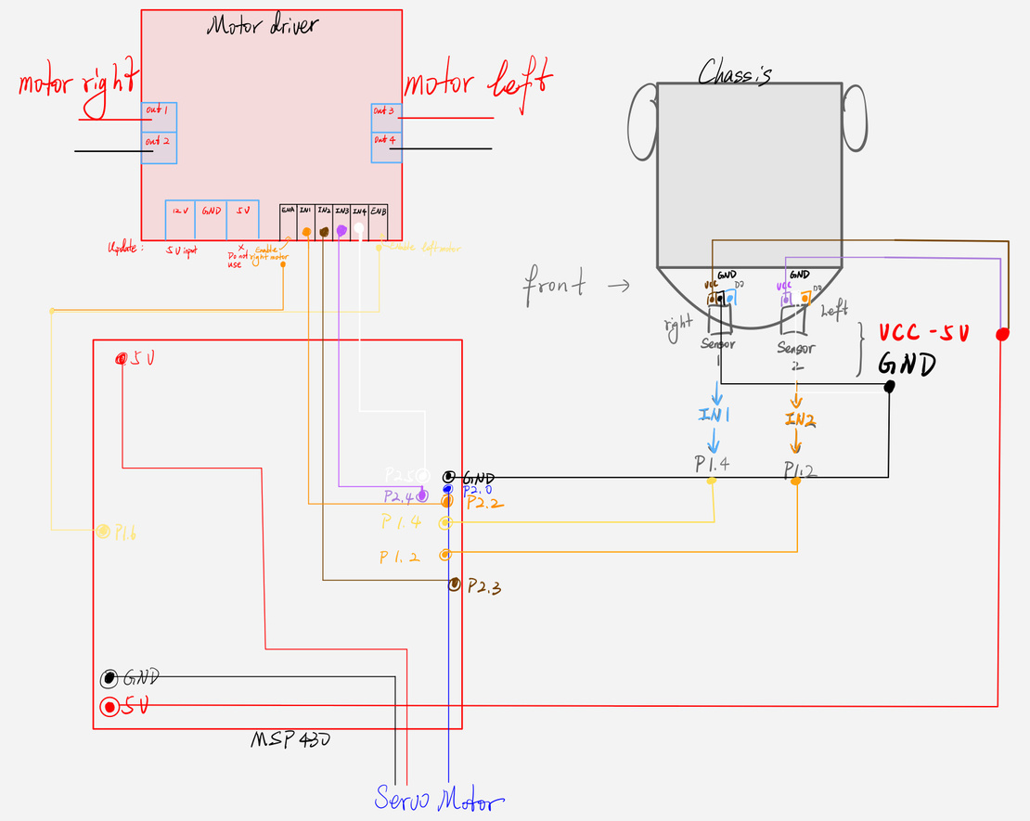
Circuit Diagram & Pin Mapping
MSP430 Pin Assignments:
P1.2: Left IR sensor input
P1.4: Right IR sensor input
P1.6: Motor driver enable (ENA/ENB)
P2.2 – P2.5: Motor driver control (IN1–IN4)
P2.0: Servo PWM output (Timer_A1.1)
Signal Flow: Sensor → MSP430 → Motor Driver & Servo

Slide 5









Code Overview
Servo PWM:
10 ms period with pulse widths from 0.3 ms to 2.5 ms.
Motor driver inputs on P2.2–P2.5 control two DC motors.
Enable pin on P1.6 is set HIGH to power the motors.
Reads IR sensor inputs from P1.2 (left) and P1.4 (right).
Simple “bang-bang” control adjusts steering and wheels based on sensor state.
setupServoPWM() configures the PWM for the servo.
setServo() clamps the PWM value within 0.3–2.5 ms.
straight(), turnright(), turnleft(), and stop() drive the motors and adjust the servo.

Slide 6




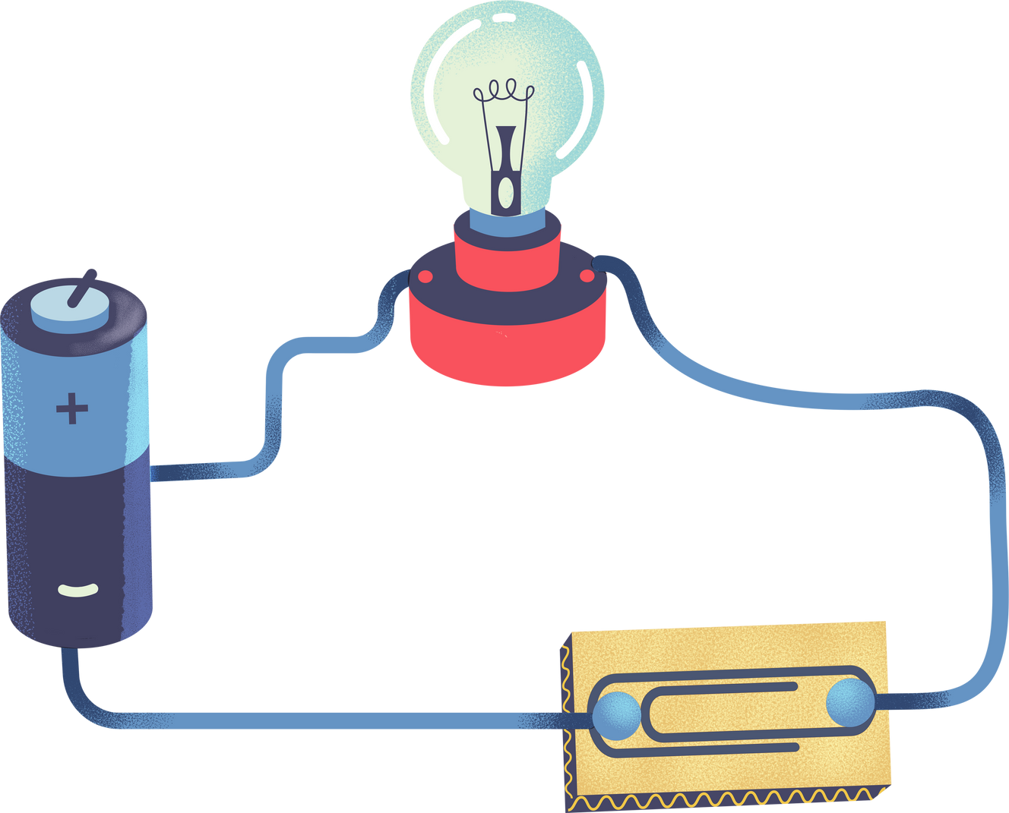

Challenges & Solutions
Broken I/O Pin:
P1.3 was non-functional.
Solution: Reassigned sensor inputs to P1.2 (left) and P1.4 (right).
Servo PWM Calibration
The servo responds inversely: a 0.3 ms pulse yields 180°, and a 2.5 ms pulse yields 0°.
Solution: Calibrated the PWM with an oscilloscope and adjusted the code accordingly.

Slide 7



Limitations & Future Improvements
Limitations
Future Improvements
Sharp Turns: The current sensor setup may not handle very abrupt (90°) turns well.
Surface Dependence: The IR sensors work best on high-contrast, matte surfaces.
I/O Constraints: Broken pins limit the number of additional sensors.
Extra Sensors: Add side sensors to improve line detection.
Advanced Control: Implement PID control for smoother steering.
Hardware Upgrades: Improve chassis stability and sensor mounting.

